Slide 1
Azure key Vaults (Part 2)+ SAS Tokens
Data read in DataBricks using SAS tokens and SAS Tokens with Azure Key Vaults
SAS – Shared Access Signature

Slide 2
How to get Data from Storage to Databricks
Access Key /Account key with Azure key Vaults (But gets full access)
SAS Tokens with Azure Key Vaults ( Gets limited Access)
Service Principal
Micro-Entra ID /Azure Active Directory (AAD)
Mount Method (Most Used)

Slide 3
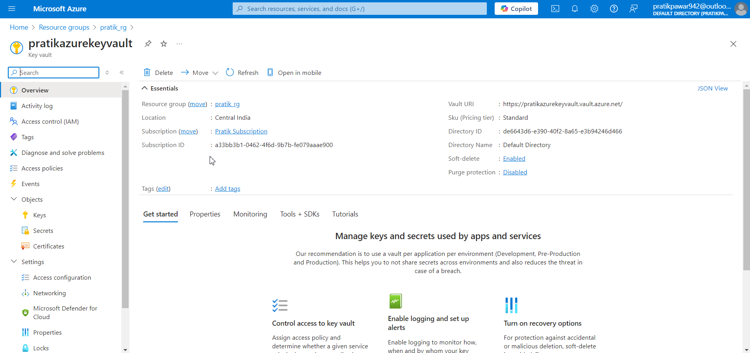
Create Databricks + AzureStorage ACC + Azure Key Vaults

Slide 4
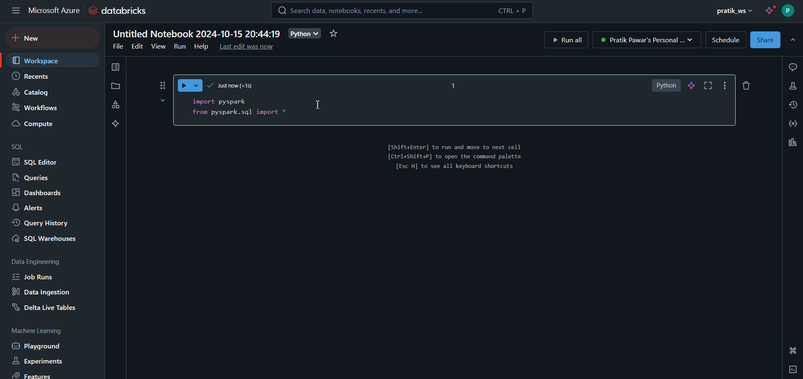
we will read data without key vaults and Scope in databricks. First run Broiler plate code

Slide 5
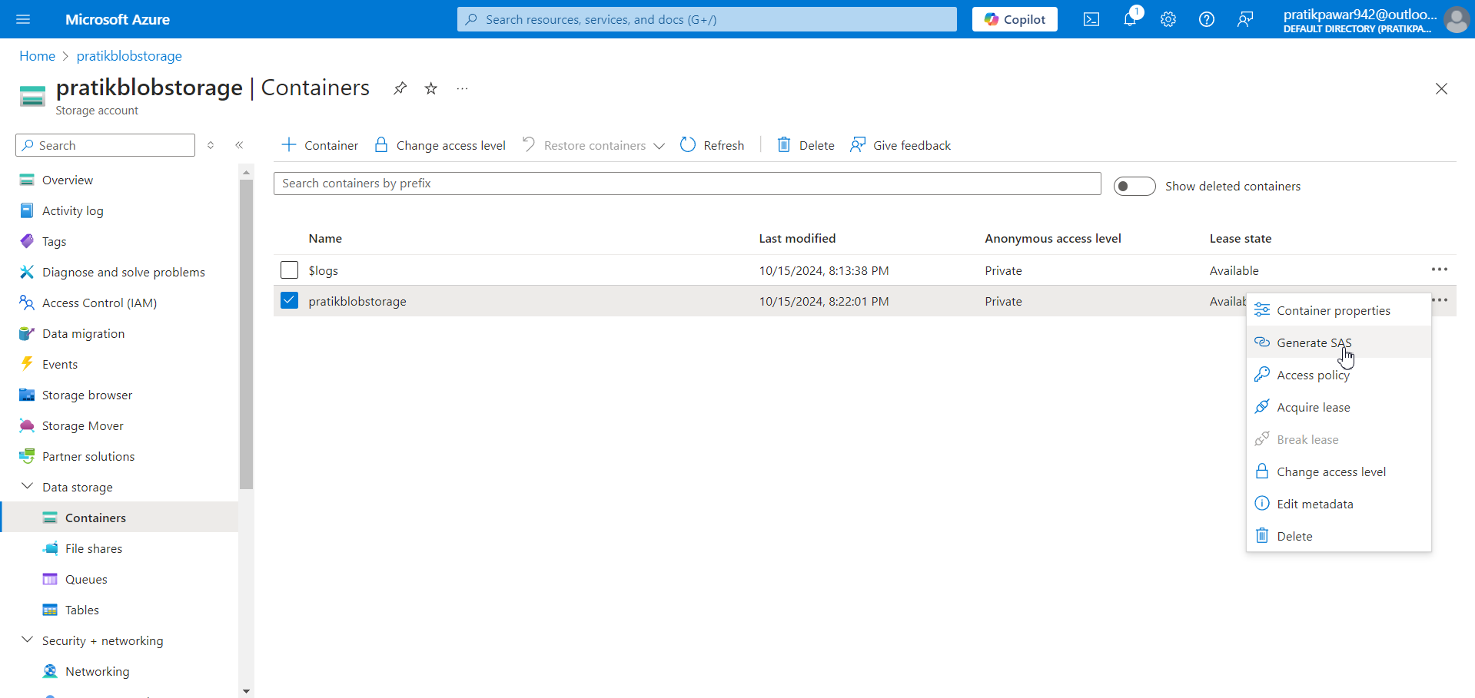
Now go to Storage (ADLS/Blob) Container > Right Click> Generate SAS

Slide 6
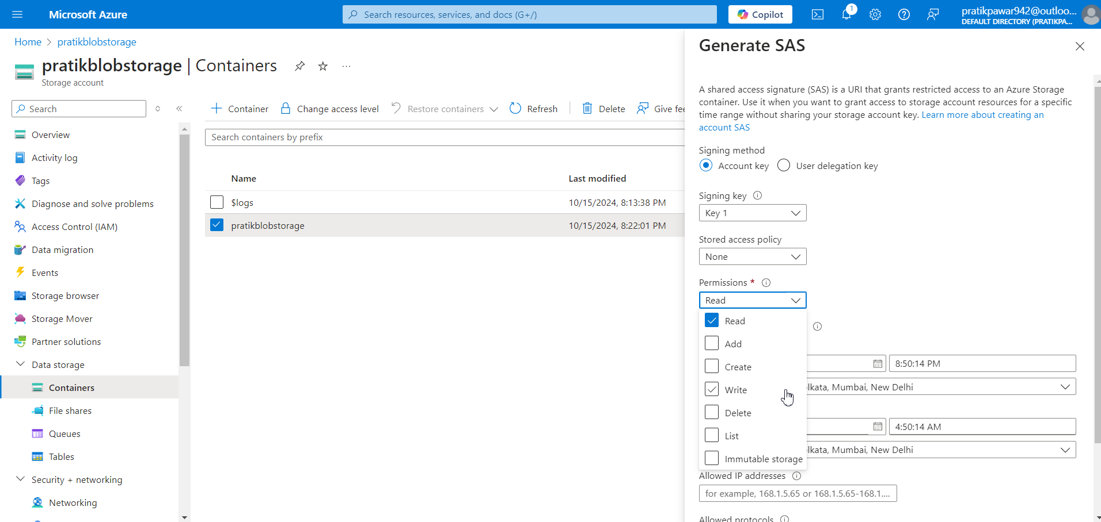
Now here we can choose what type of access can I give to team members like read , add , create, etc

Slide 7
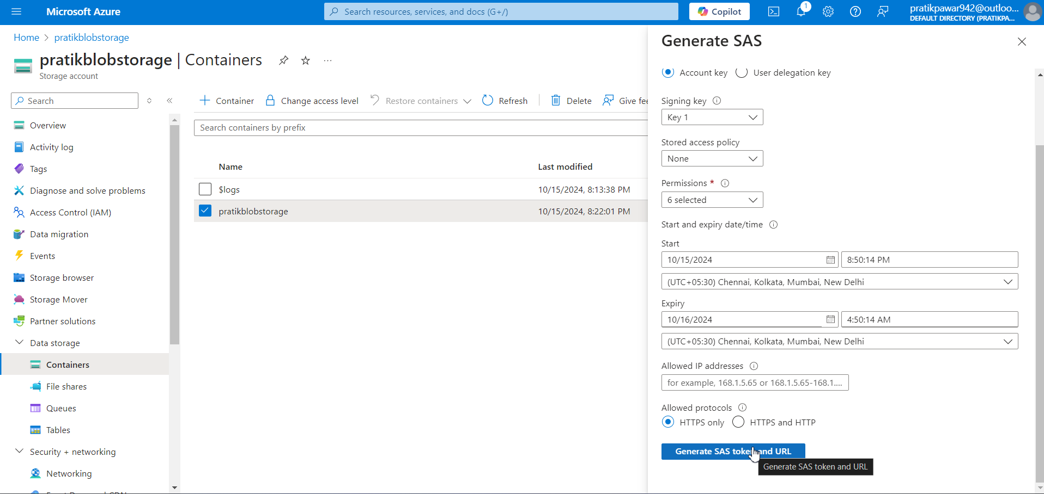
Generate SAS Token

Slide 8
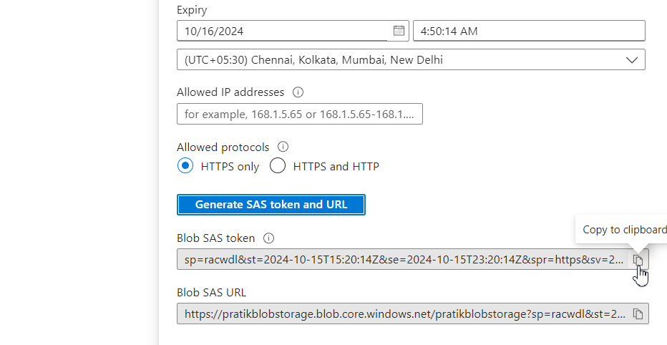
Copy SAS Token

Slide 9
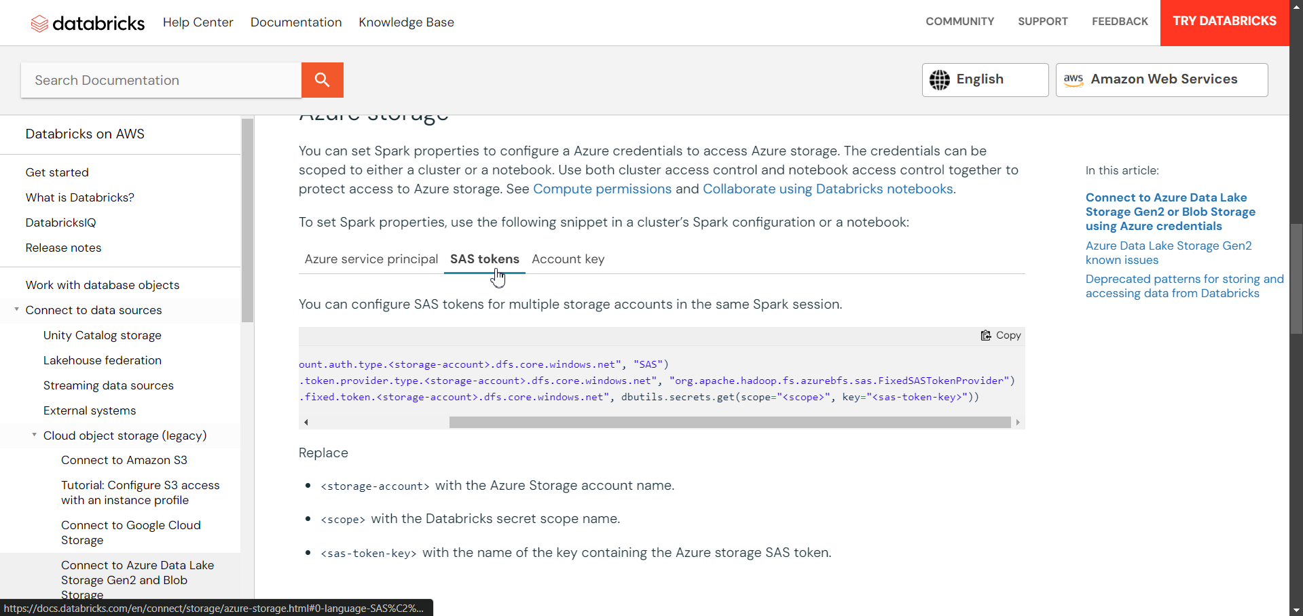
Get Conf code from databricks official website of SAS tokens

Slide 10
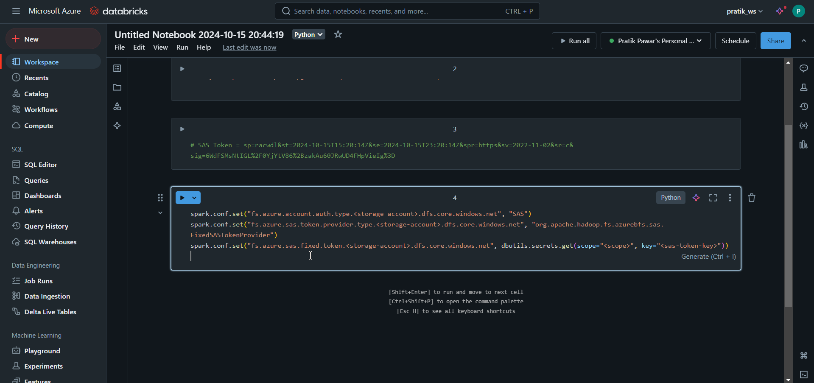
This is Conf of sas Token to connect

Slide 11
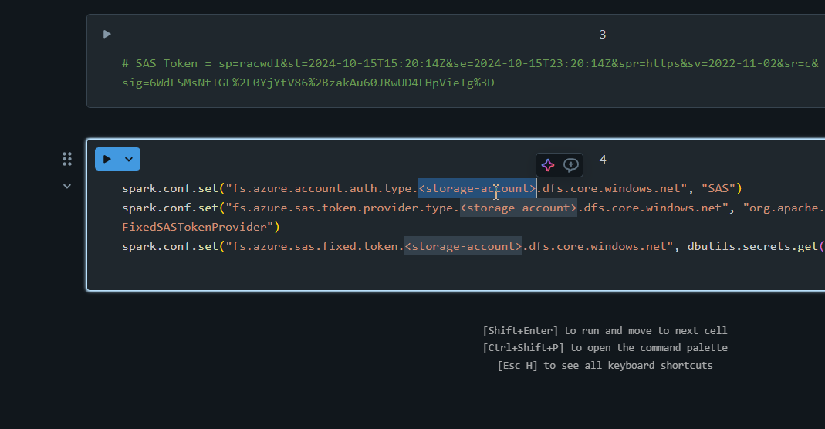
Now replace this three with storage account name

Slide 12
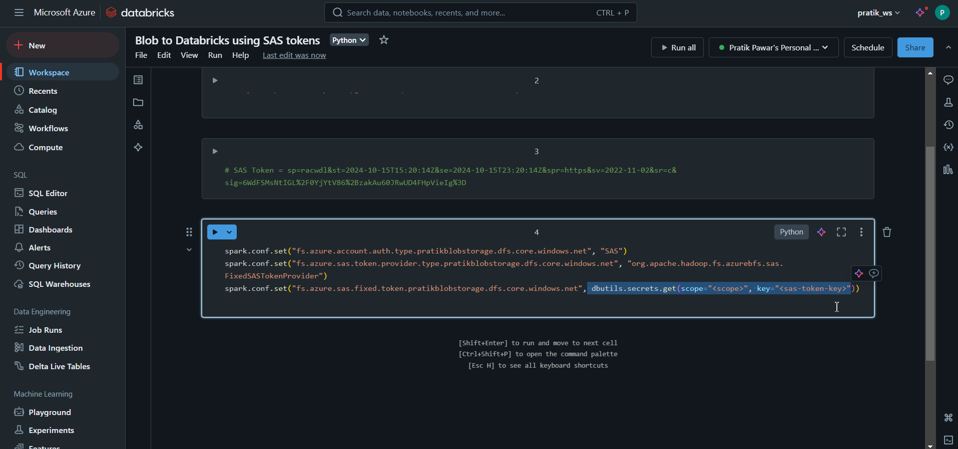
Now replace this with SAS token we have copied

Slide 13
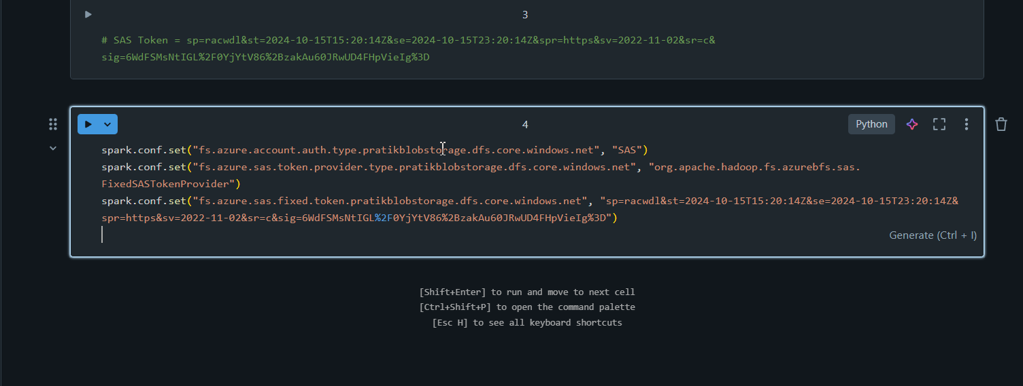
Now this is Conf Code to Connect to Storage Account

Slide 14
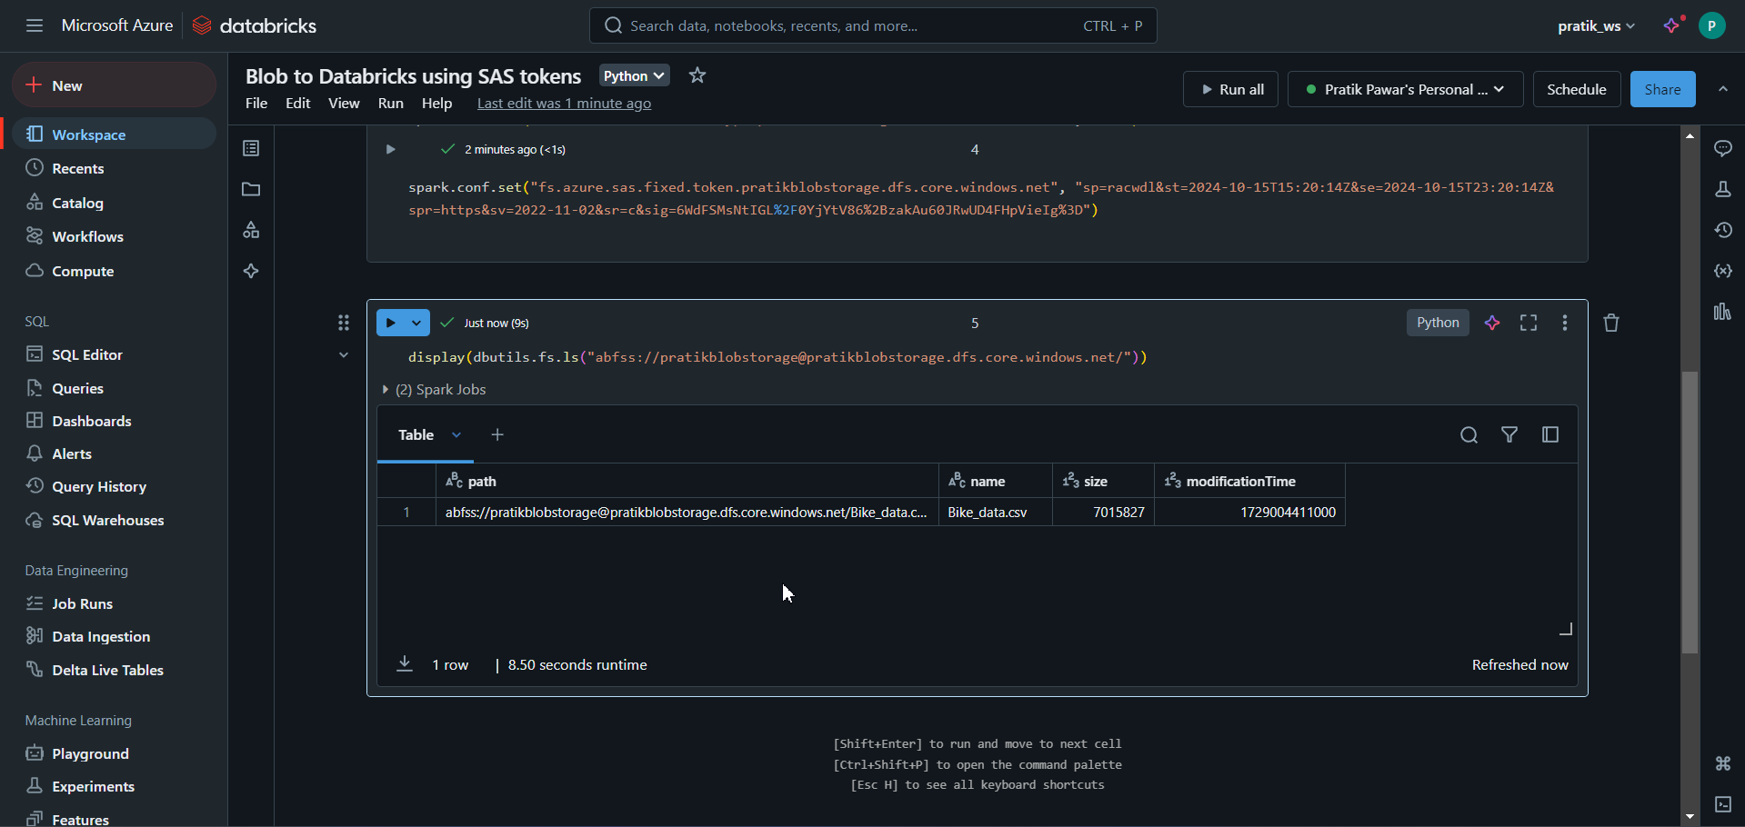
Now Using Display dbutils we can see files in Container using SAS Tokens

Slide 15
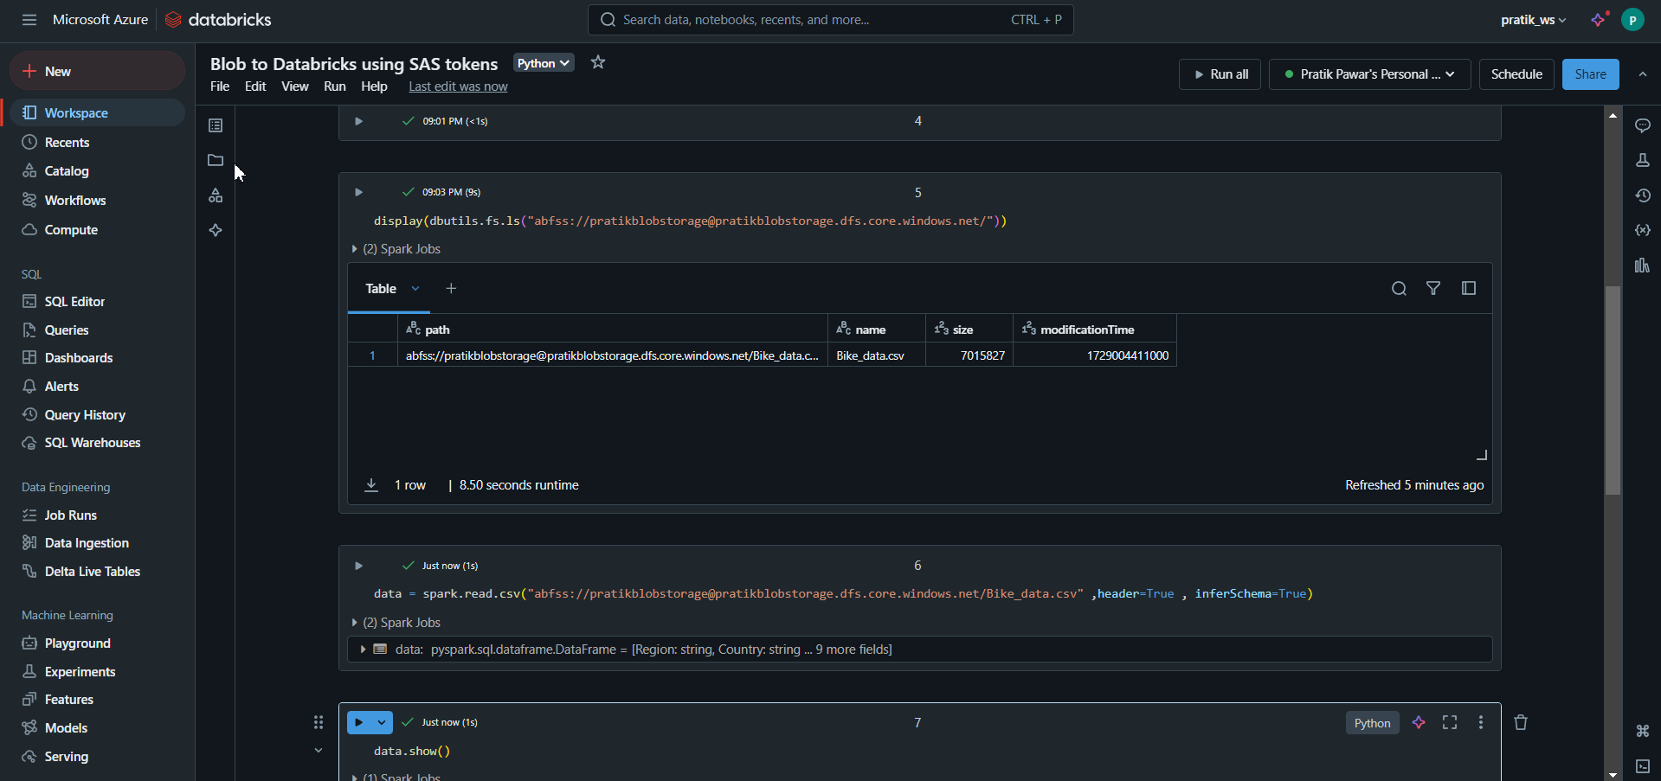
Now just using path we can read the data

Slide 16
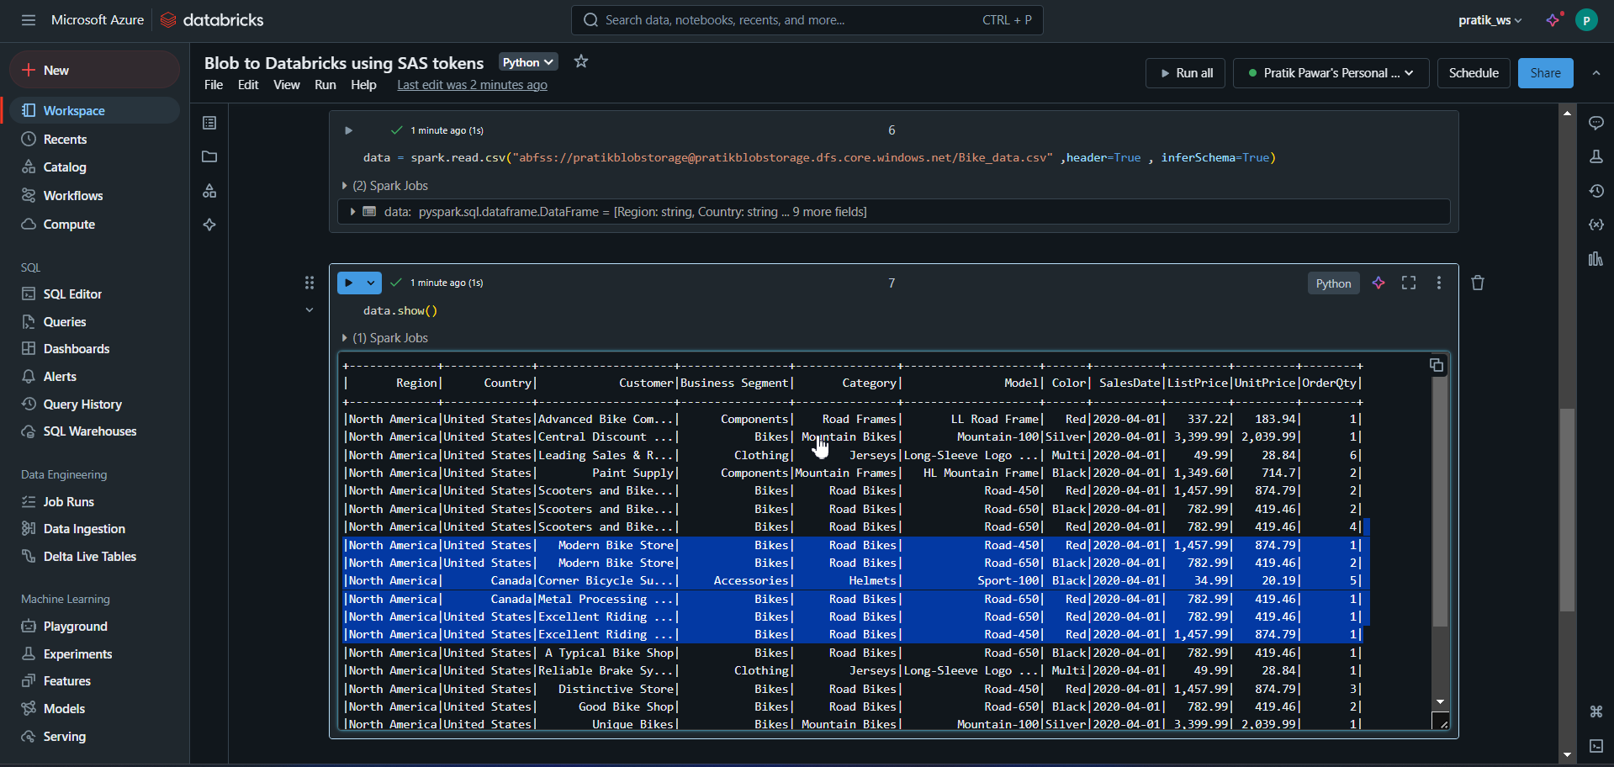
Read data with Azure Key Vaults

Slide 17
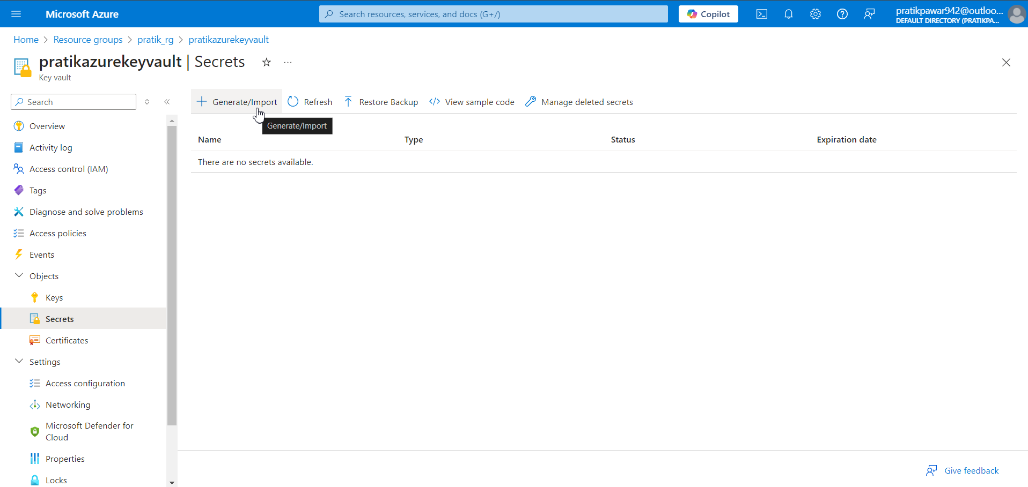
Now with Key Vaults. Go to Key Vaults > Secrets > Generate

Slide 18
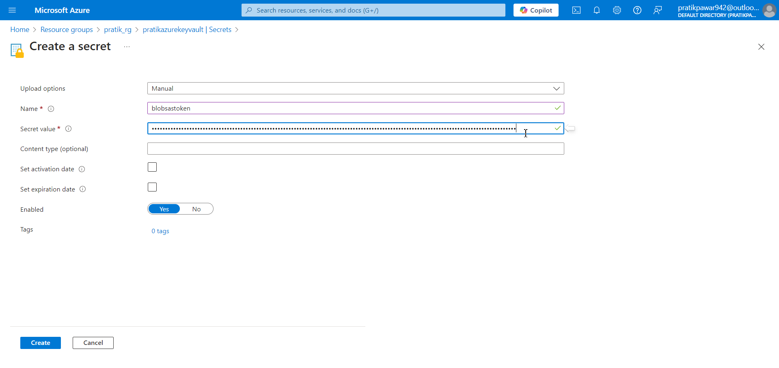
Give Name and Secret Value as SAS Token > Create

Slide 19
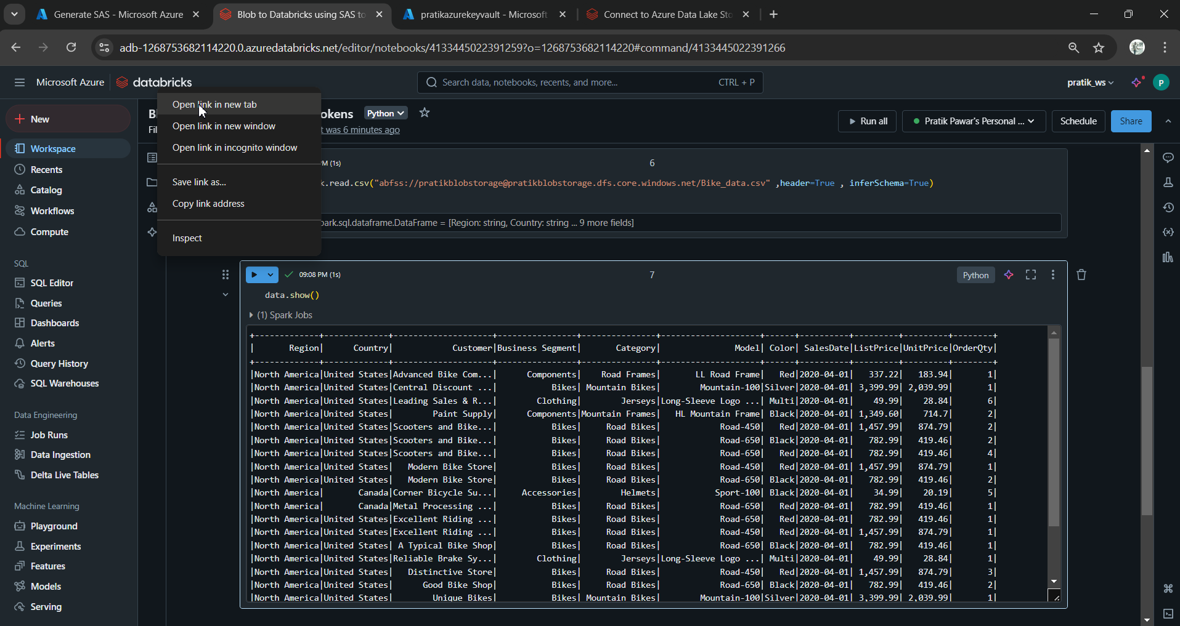
Now open Databricks in New tab

Slide 20
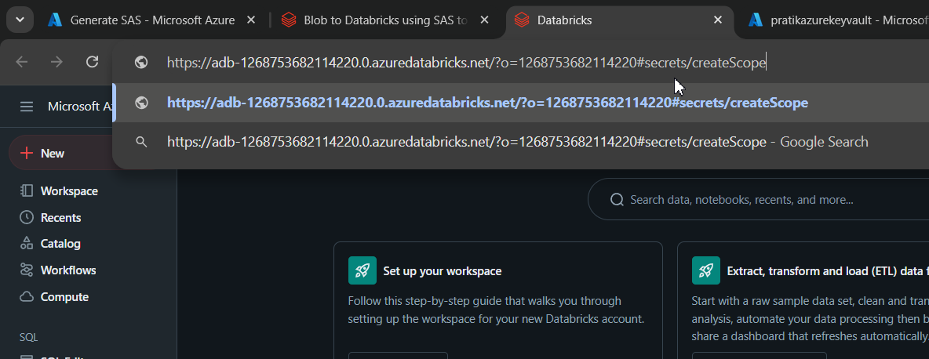
Now after the website url type ‘ #secrets/createScope

Slide 21
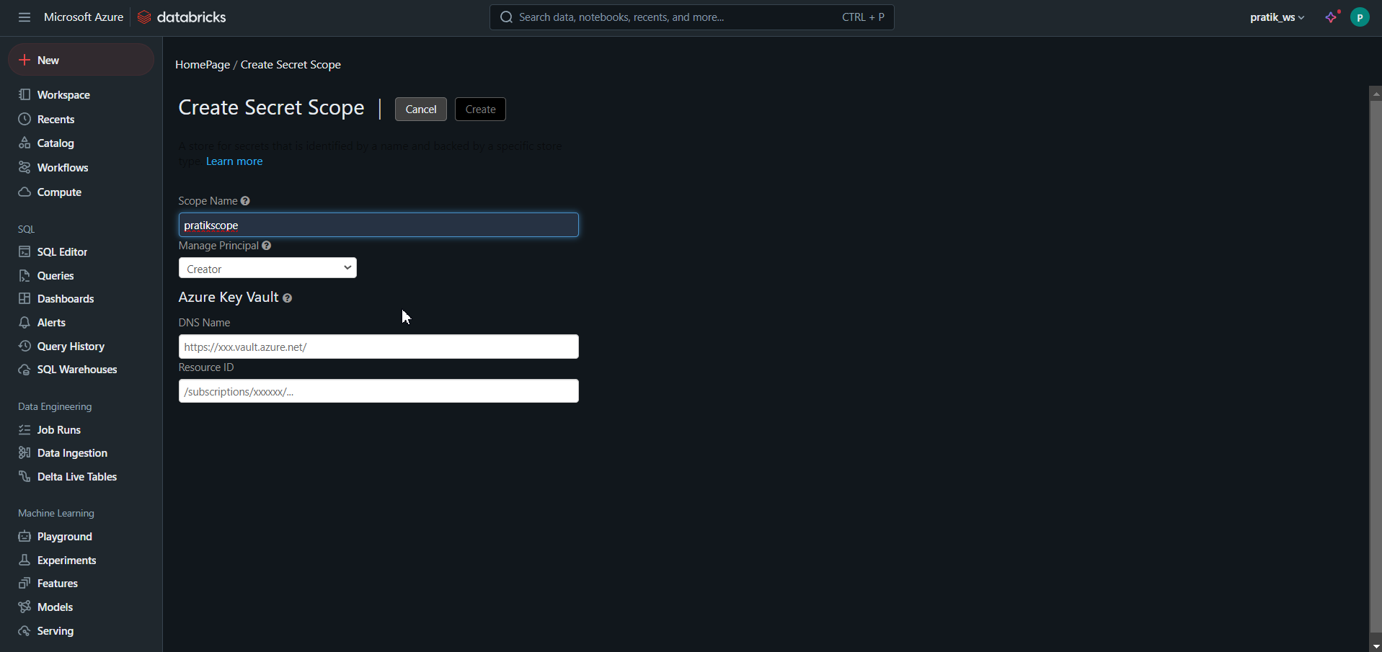
Type Scope name and DNS And Resource ID from Key Vaults

Slide 22
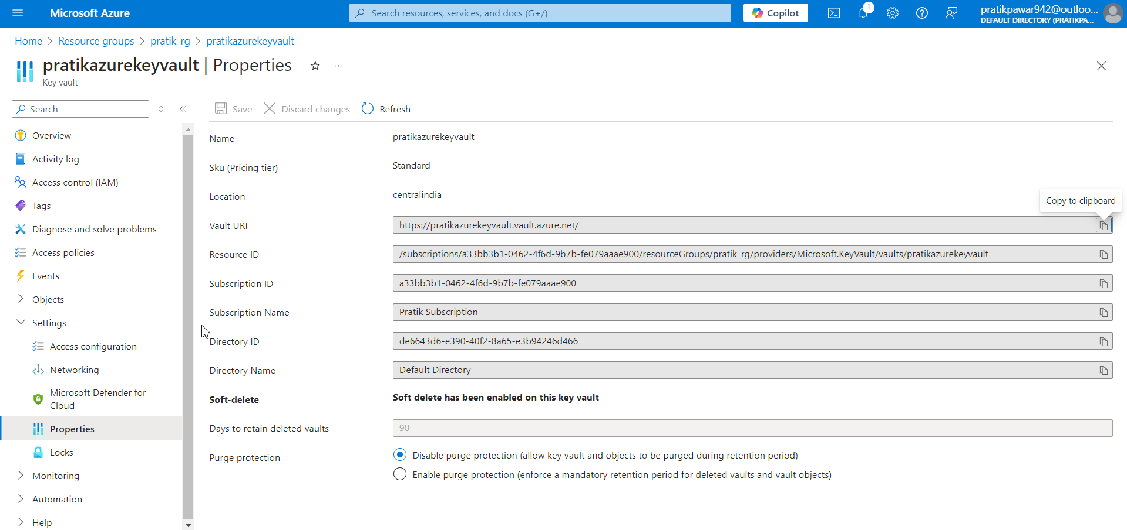
Now go to Key Vaults > Settings > Properties and Copy Vaults URI and Resource ID in Databricks Scope

Slide 23
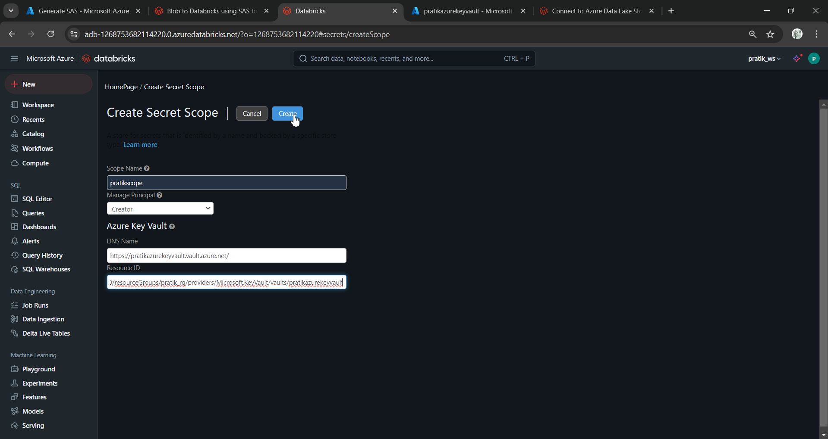
Create

Slide 24
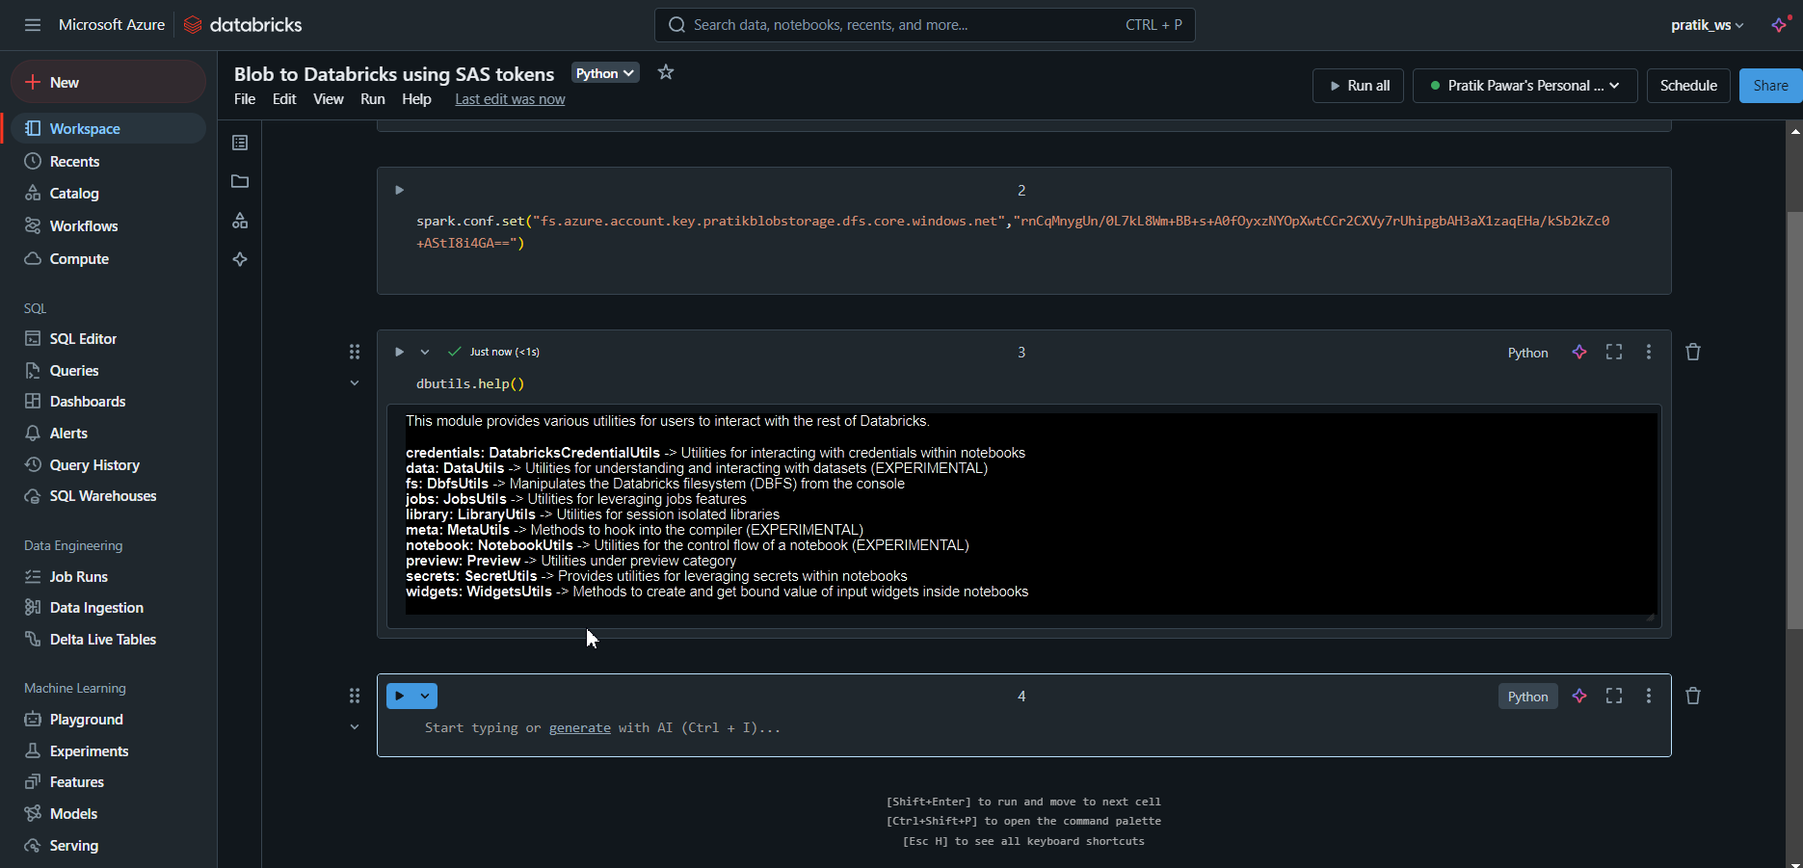
Dbutils.help()

Slide 25
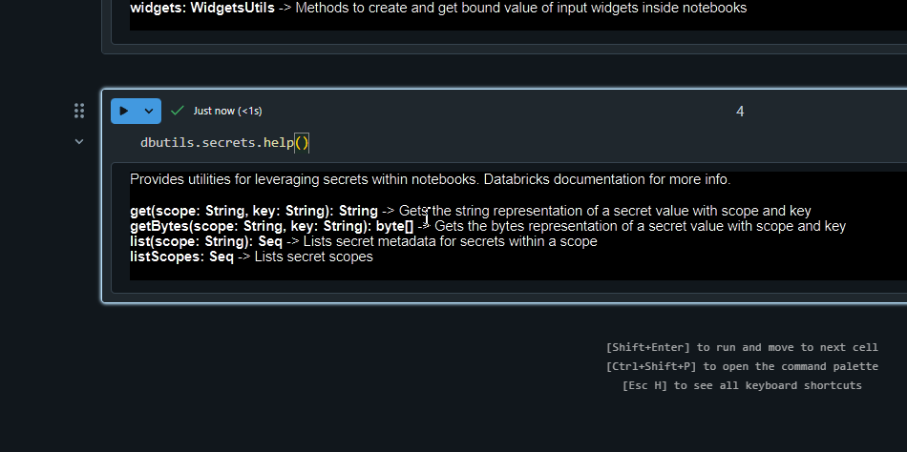
Dbutils.secrets.help()

Slide 26
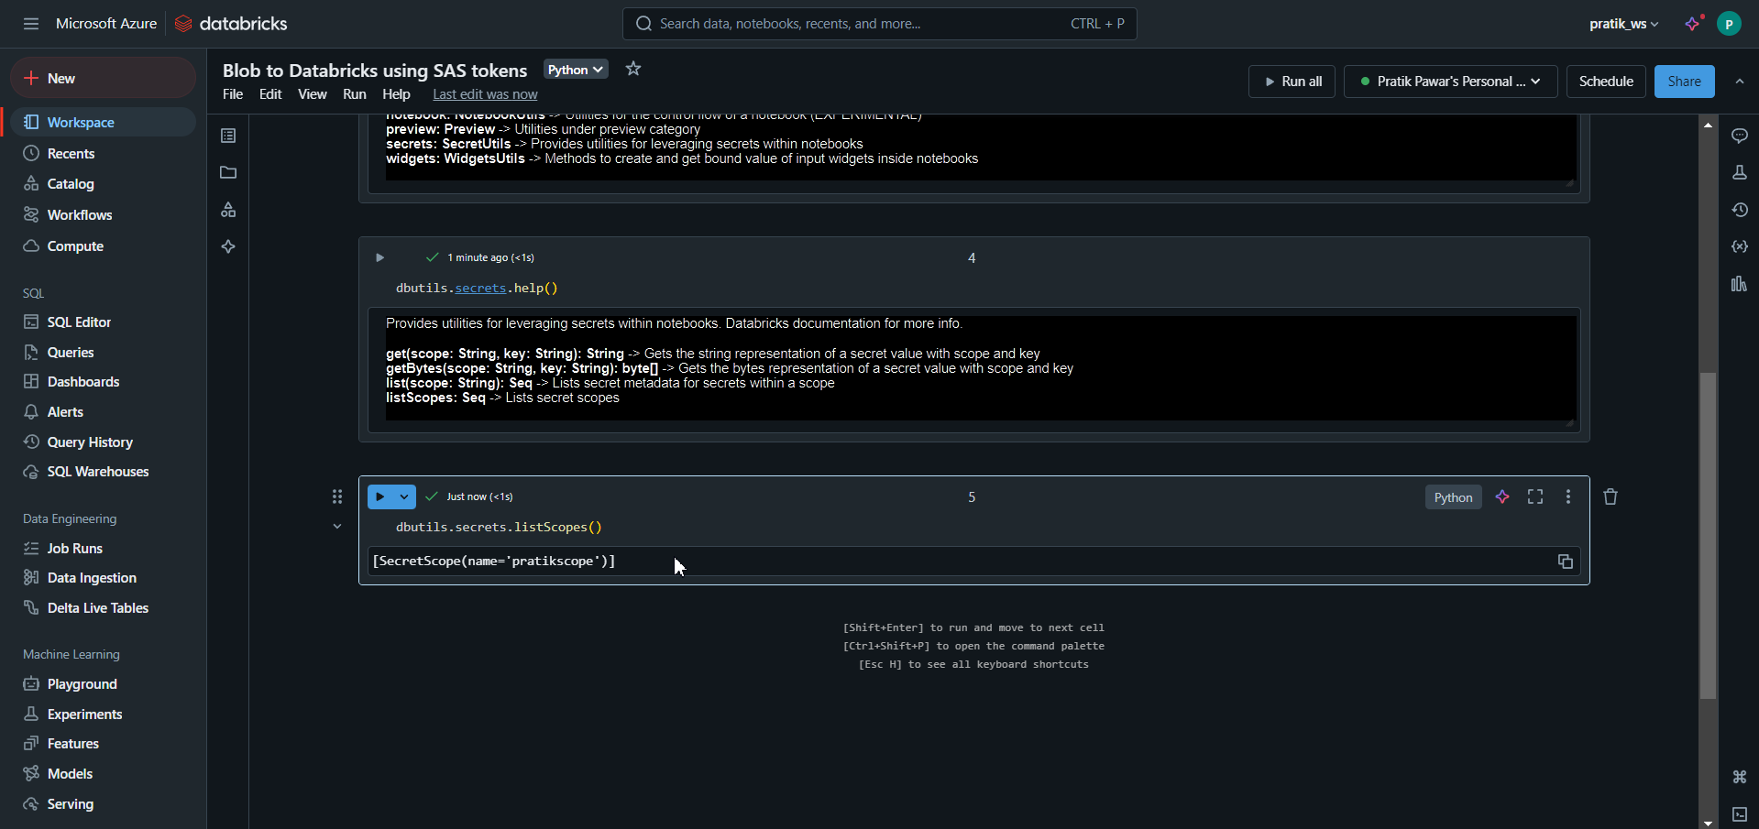
Dbutils.secrets.listScopes()

Slide 27
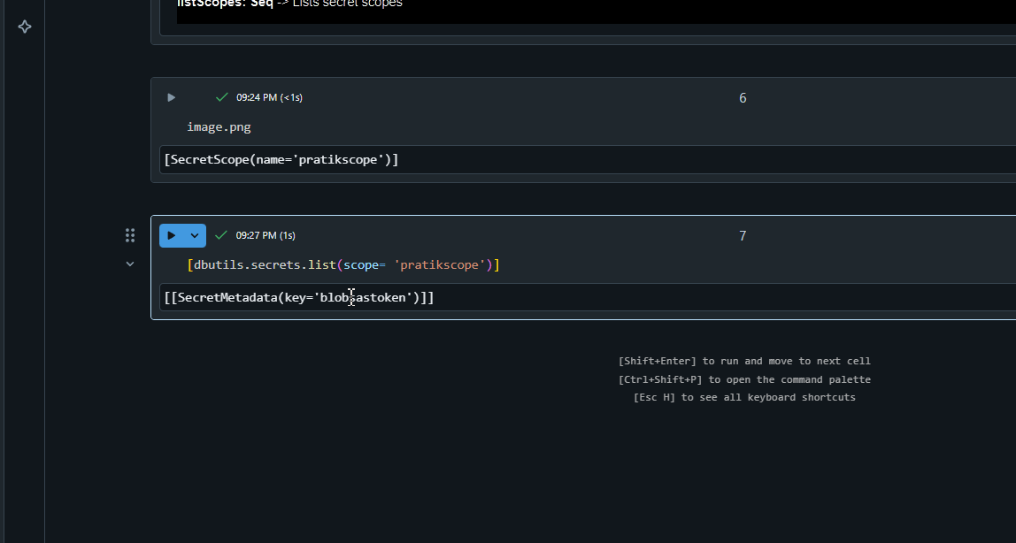
Now this is the key copy it as while working jr members have to extract like this

Slide 28
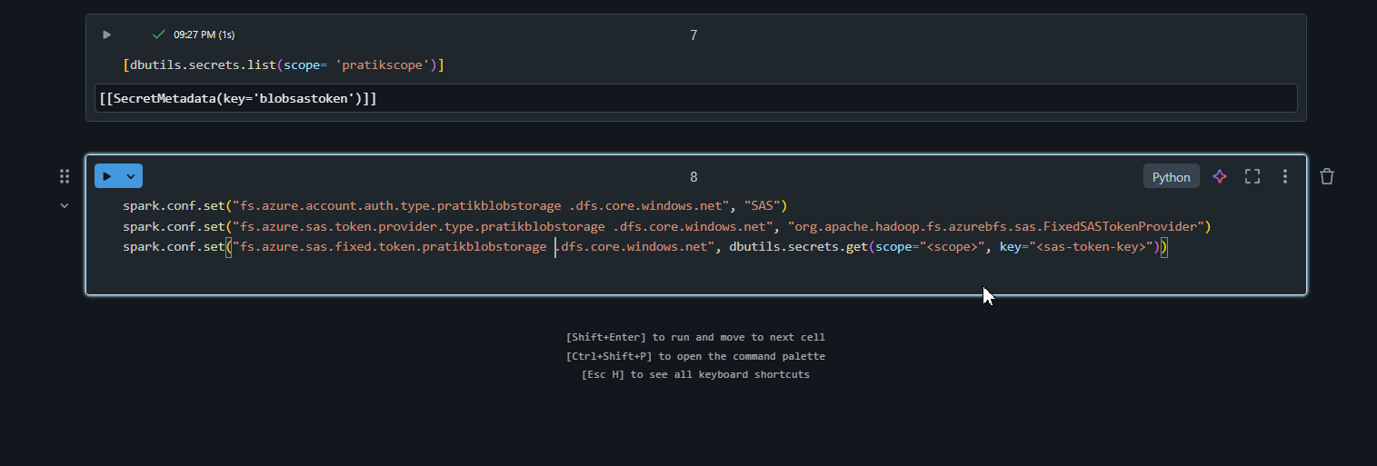
Now replace scope and sas token key with it names

Slide 29
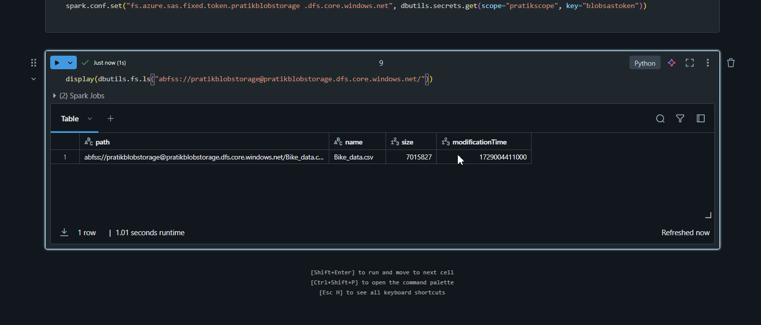
Now we get path using display.dbutils

Slide 30
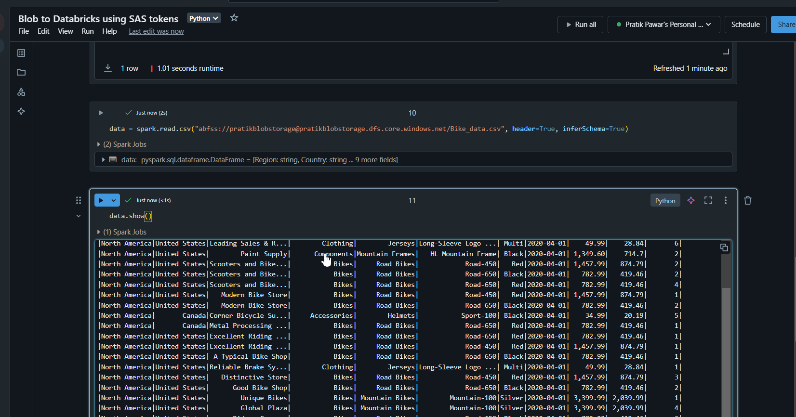
Finally read data using Azure key vaults and SAS token

